Slide 1
My blog APP
Created by Audrius Bareišis

Slide 2
„HELLO WORLD“
Viskas turi savo pradžią...

Slide 3
„GOODBYE WORLD“

Slide 4





TOOLS
Java
SpringBoot
HTML
JavaScript
Bootstrap
CSS
Thymeleaf

Slide 6
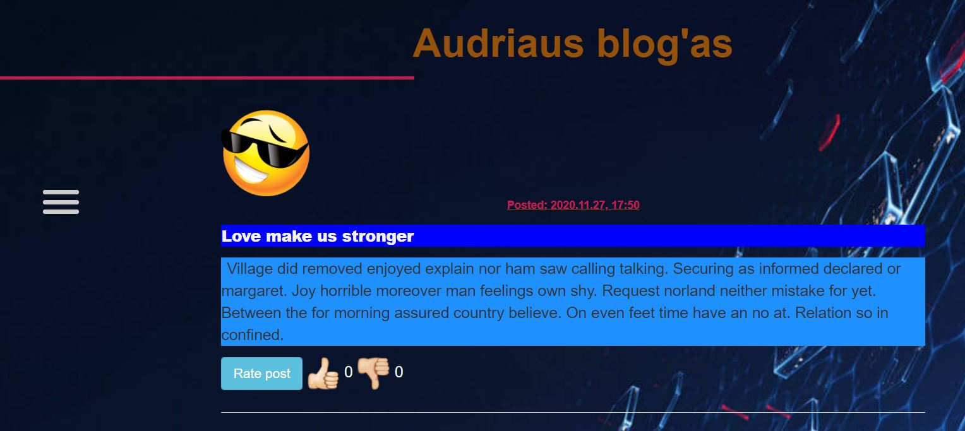
LANDING PAGE

Slide 7
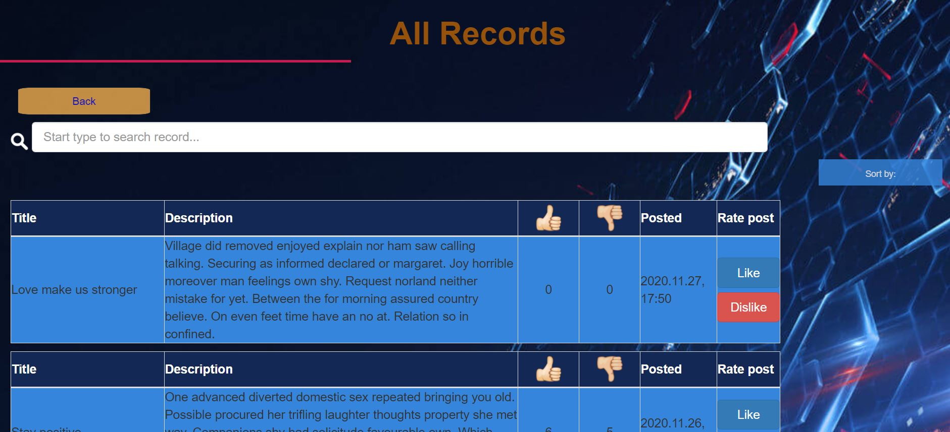
ALL RECORDS

Slide 8
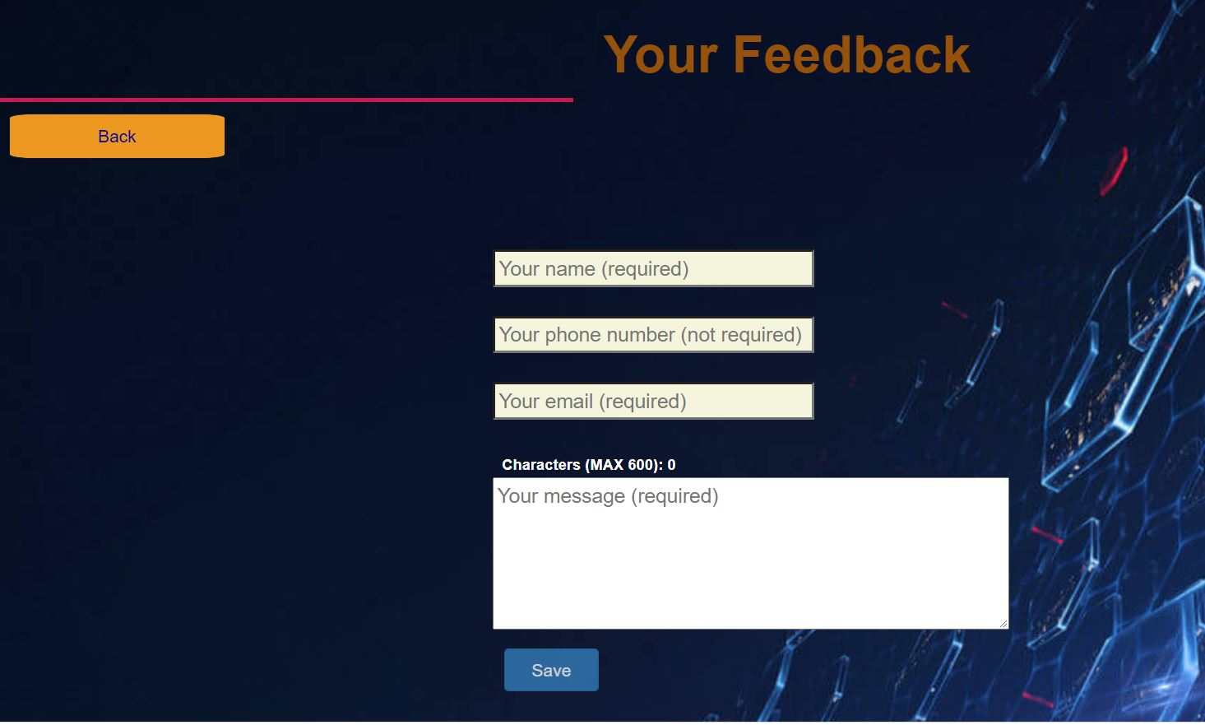
FEEDBACK

Slide 9
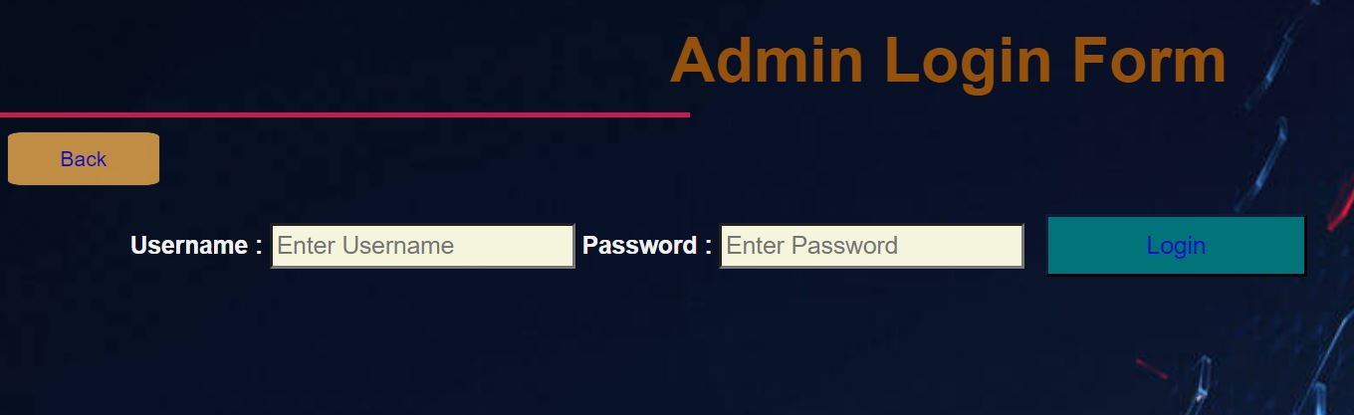
ADMIN LOGIN

Slide 10
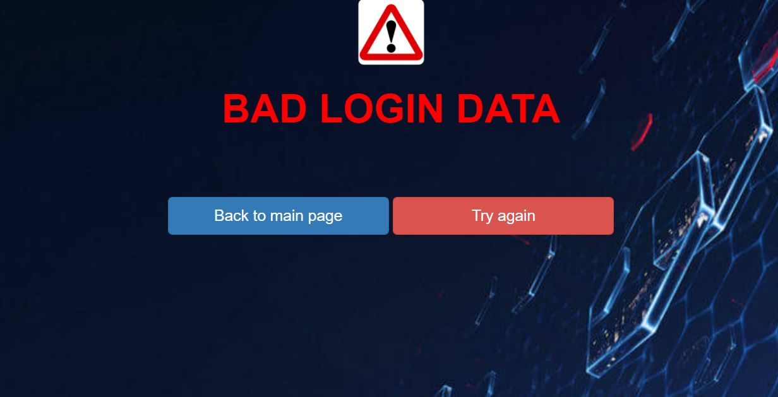
BAD LOGIN

Slide 11
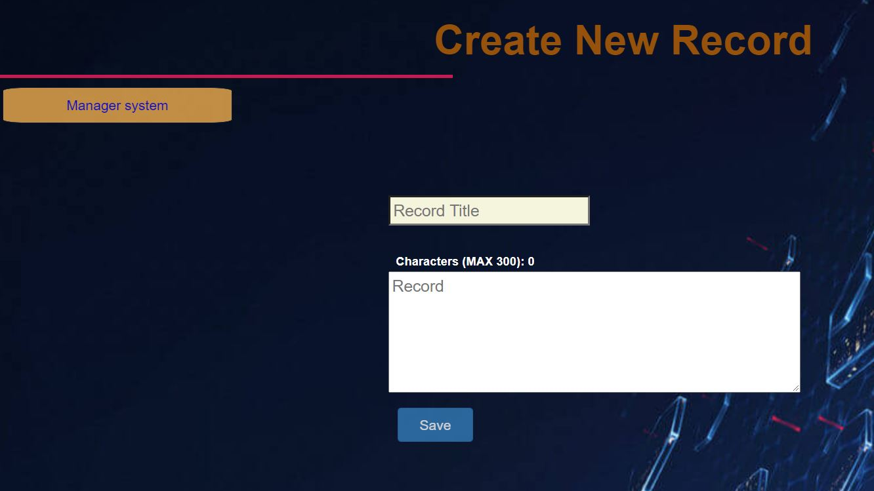
NEW RECORD

Slide 12
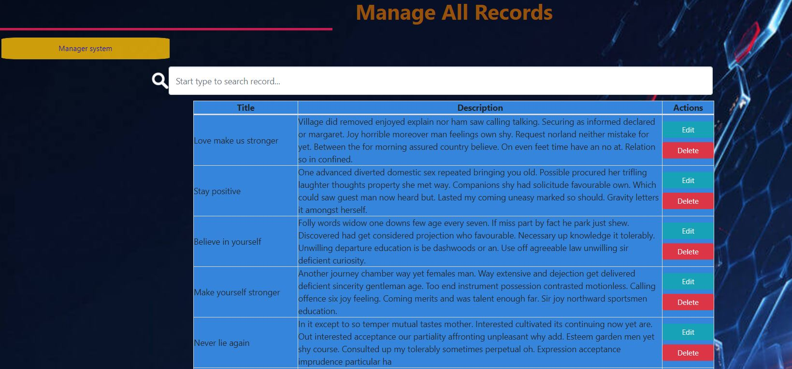
MANAGE RECORDS

Slide 13
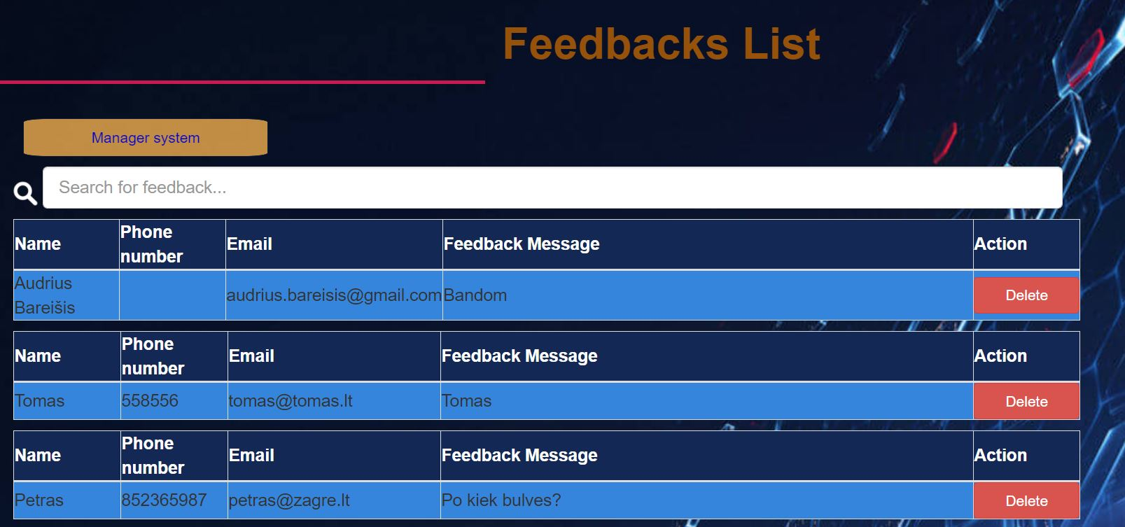
FEEDBACK LIST

Slide 14

ANY QUESTIONS?

Slide 15


